Slide 1
OS’26-27 Project
PART 0: ROADMAP

Slide 2

Agenda
PART 0: ROADMAP
PART I: PREREQUISITES
PART II: GROUP MODULES
PART III: INDIVIDUAL MODULES
PART IV: OVERALL TESTING & BONUSES

Slide 3
Agenda
PART 0: ROADMAP
  Registration
  Project Overview
  Supportive Materials
  Logistics & Delivery
  Advices

Slide 4
Registration
Register your team info [4~6 members] at this form
Due: FRI 16 OCT 23:59 isA
Each member MUST select different individual module in their order
Reminder: “CAREFULLY SELECT TEAM - WORK AS A TEAM…”

Slide 5
Project Overview
10
MARKS
Prerequisite Modules
(Teamwork)
[TW] Prerequisite Modules
Dyn. Alloc, Kern Heap, Fault Handl. 1, Blocking
10
MARKS
[M#1]
Fault Handl. 2
Individual Module#1
Individual Module#2
[M#2]
User Heap
Individual Module#3
Individual Module#4
Individual Module#5
[M#3]
CPU Sched.
[M#4]
IPC #1
[M#5]
IPC #2
5
MARKS
[TW] Integration & Overall Testing
Scenarios & Bonuses
Integration & Overall Testing
(Teamwork)
Notes:
Inshaa’ALLAH

Slide 6
Project Overview
4 members
10
MARKS
Prerequisite Modules
(Teamwork)
[TW] Prerequisite Modules
Dyn. Alloc, Kern Heap, Fault Handl. 1, Blocking
10
MARKS
[M#1]
Fault Handl. 2
Individual Module#1
Individual Module#2
[M#2]
User Heap
Individual Module#3
Individual Module#4
Individual Module#5
[M#3]
CPU Sched.
[M#4]
IPC #1
[M#5]
IPC #2
5
MARKS
[TW] Integration & Overall Testing
Scenarios & Bonuses
Integration & Overall Testing
(Teamwork)
Notes:
Inshaa’ALLAH

Slide 7
Project Overview
6 members
10
MARKS
Prerequisite Modules
(Teamwork)
[TW] Prerequisite Modules
Dyn. Alloc, Kern Heap, Fault Handl. 1, Blocking
10
MARKS
[M#1]
Fault Handl. 2
Individual Module#1
Individual Module#2
[M#2]
User Heap
Individual Module#3
Individual Module#4
Individual Module#5
[M#6]
Shared Mem
[M#3]
CPU Sched.
[M#4]
IPC #1
[M#5]
IPC #2
5
MARKS
[TW] Integration & Overall Testing
Scenarios & Bonuses
Integration & Overall Testing
(Teamwork)
Notes:
Inshaa’ALLAH

Slide 8
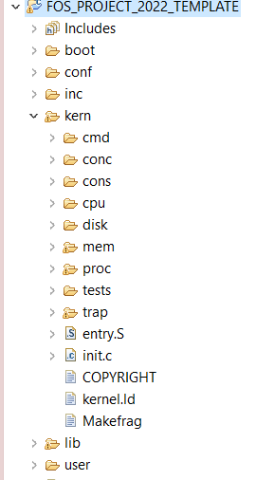




PROJECT BIG PICTURE
inc (.h)
CPU Sched.
Kheap, Share
lib (.c)
IPC
ipc
Fault Handler
user
kern
Dyn Alloc, Uheap,
IPC

Slide 9
Agenda
PART 0: ROADMAP
  Registration
  Project Overview
  Supportive Materials
  Logistics & Delivery
  Advices

Slide 10
Supportive Materials – CODES
APPENDICES:
STRING HELPER FUNCTIONS
LISTS HELPER MACROS
ENTRY MANIPULATION in TABLES and DIRECTORY
MEMORY MANAGEMENT FUNCTIONS
SHARED MEMORY STRUCTURE & HELPER FUNCTIONS
PAGE FILE HELPER FUNCTIONS
WORKING SET STRUCTURE & HELPER FUNCTIONS
CPU STRUCTURE & HELPER FUNCTIONS
SCHEDULER STRUCTURE & HELPER FUNCTIONS
PROTECTION PRIMITIVES
READY-MADE COMMANDS

Slide 11
Supportive Materials – VIDEOS
  How to import a new project into eclipse? [link]
  Debugging:
    Debug KERN Code via breakpoints (ECLIPSE) [link]
    Debug USER Code via breakpoints (ECLIPSE) [link]
    Debug any code via printing [link: 1st minute]
    Locate the line causing exception via disassembly [link]

Slide 12
Supportive Materials – TESTING
  Set of modular tests for each module [seen & unseen]
  Helps to discover some bugs
  Successful Test ≢ 100% Correctness
Be LOGIC-DRIVEN... Not TEST-DRIVEN
Tests will be released later isA

Slide 13
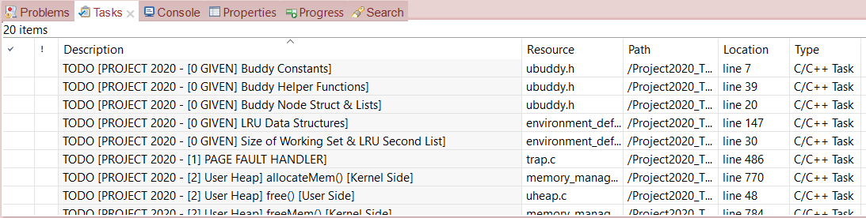
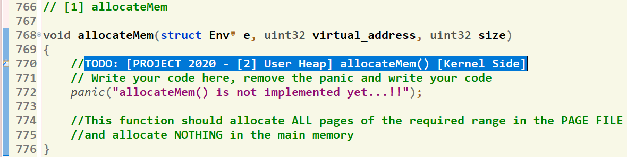
Where should I write the Code?
There’re shortcut links that direct you to the function definition
[1] Click on “Tasks” Tab
[2] Double Click on the required function
GIVEN
REQUIRED
[3] Function body, at which you should write the code
13

Slide 14
Agenda
PART 0: ROADMAP
  Registration
  Project Overview
  Supportive Materials
  Logistics & Delivery
  Advices

Slide 15
Logistics
Startup Code:
  FOS_PROJECT_2026_template.zip
  Follow these steps OR check this video to import the project folder into the eclipse
Delivery Method: GOOGLE FORM
  It’s FINAL delivery
  MUST deliver the required tasks and ENSURE they’re worked correctly
Delivery Dates:
  Week #12 (SAT 5 DECEMBER) isA
  Upload your code EARLY as NO EXCEPTION will be accepted.
Support:
  The support for teams will be through their MENTORS ONLY (+Lecturer) during via:
    MAIN METHOD: weekly office hours.
    SECONDARY METHOD [OPTIONAL]: other contact method

Slide 16
Submission Rules
Read the following instructions as the code correction is done AUTOMATICALLY. Any violation in these rules will lead to 0 and, in this case, nothing could be happened.
First ensure the following that (READ CAREFULLY):
  You tested each function in a FRESH RUN and a congratulations message have been appeared.
  NO CODE with errors WILL BE CORRECTED. So, CLEAN & RUN your project several times before your submission.
  You submitted BEFORE the deadline by several hours to AVOID any internet problems.
  DEADLINE: Week #12 (BEG of DECEMBER) isA
  NO DELAYED submissions WILL BE ACCEPTED.
  ONLY ONE person from the team shall submit the code.
  The TEAM # MUST BE CORRECT.
  DON’T take the FORM LINK FROM ANYONE. OPEN the form from its LINK ONLY. Otherwise, your submission is AUTOMATICALLY CANCELLED by GOOGLE.
  You MUST RECEIVE A MAIL FROM GOOGLE with your submission after clicking submit. If nothing received, re-submit again to consider your submission.

Slide 17
Submission Steps
STEPS to SUBMIT:
  Step 1: Clean & run your code the last time to ensure that there are any errors.
  Step 2: Create a new folder and name it by your team number ONLY. Example 1 or 95. [ANY extra chars will lead to 0].
  Step 3: DELETE the “obj” folder from the “FOS_PROJECT_2026_Template”
  Step 4: PASTE the “FOS_PROJECT_2026_Template” in the folder created in step #2.
  Step 5: Zip the created new folder. Its name shall be like [num of your team.zip]. [ANY extra chars will lead to ZERO].
  Step 6: Open the form from HERE.
  Step 7: Fill your team’s info .. Any wrong information will cancel your submission, revise them well.
  Step 8: Upload the zipped folder in step 5 to the form in its field.
  Step 9: MUST RECEIVE A MAIL from GOOGLE with your submission, otherwise re-submit again.

Slide 18
Agenda
PART 0: ROADMAP
  Registration
  Project Overview
  Supportive Materials
  Logistics & Delivery
  Advices

Slide 19

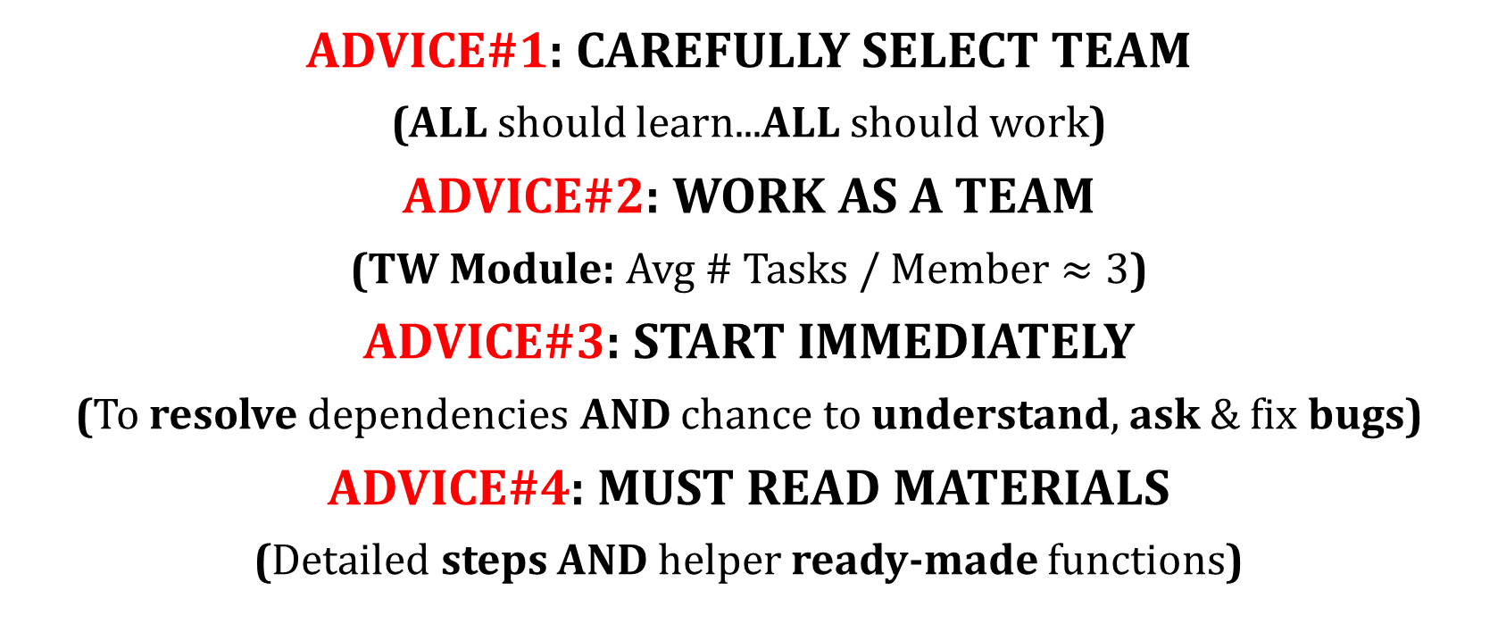
ADVICE#1: CAREFULLY SELECT TEAM
(ALL should learn...ALL should work)
ADVICE#2: WORK AS A TEAM
(TW Module: Avg # Tasks / Member $≈3$)
ADVICE#3: START IMMEDIATELY
(To resolve dependencies AND chance to understand, ask & fix bugs)
ADVICE#4: MUST READ MATERIALS
(Detailed steps AND helper ready-made functions)

Slide 20
Time Plan
ALL
W#4
Deep Understanding & Registration
W#5
W#9
W#10
W#12
GROUP: Final Delivery
GROUP: Dynamic Allocator & Blocking
W#6
GROUP: Kernel Heap & Fault Handler
W#7
W#8
W#11
MIDTERM
GROUP: Testing
INDIVIDUAL: Coding & Testing I
INDIVIDUAL: Coding & Testing II
GROUP: Integration & Overall Testing
TEAMWORK
TEAMWORK
INDIVIDUAL WORK
TEAMWORK

Slide 21
Dependencies & Suggested Distribution
2 Members
2 Members
1 Member
1~2 Members
M#2
M#1
M#3
M#6
M#1
M#4
M#5
Dynamic Allocator
[TW] Prerequisite Modules
Dyn. Alloc, Kern Heap, Fault Handl. 1, Blocking
Kernel Heap
Fault Handler I
Blocking
[M#1]
Fault Handl. 2
[M#5]
IPC #2
Individual Module#1
Individual Module#2
[M#2]
User Heap
Individual Module#3
Individual Module#4
[M#6]
Shared Memory
[M#3]
CPU Sched.
[M#4]
IPC #1

Slide 22
CAUTION
During your solution, any SHARED data MUST be PROTECTED by critical section via LOCKS
ACTION
CORRECTNESS by DESIGN
Be LOGIC-DRIVEN... Not TEST-DRIVEN

Slide 23

LET’S START OUR JOURNEY...
☺ Enjoy developing your own OS ☺

